Slide 1



WELCOME
School Board Member Patti Rendon
Cell Phone Policy
TownHall Meeting

Slide 2
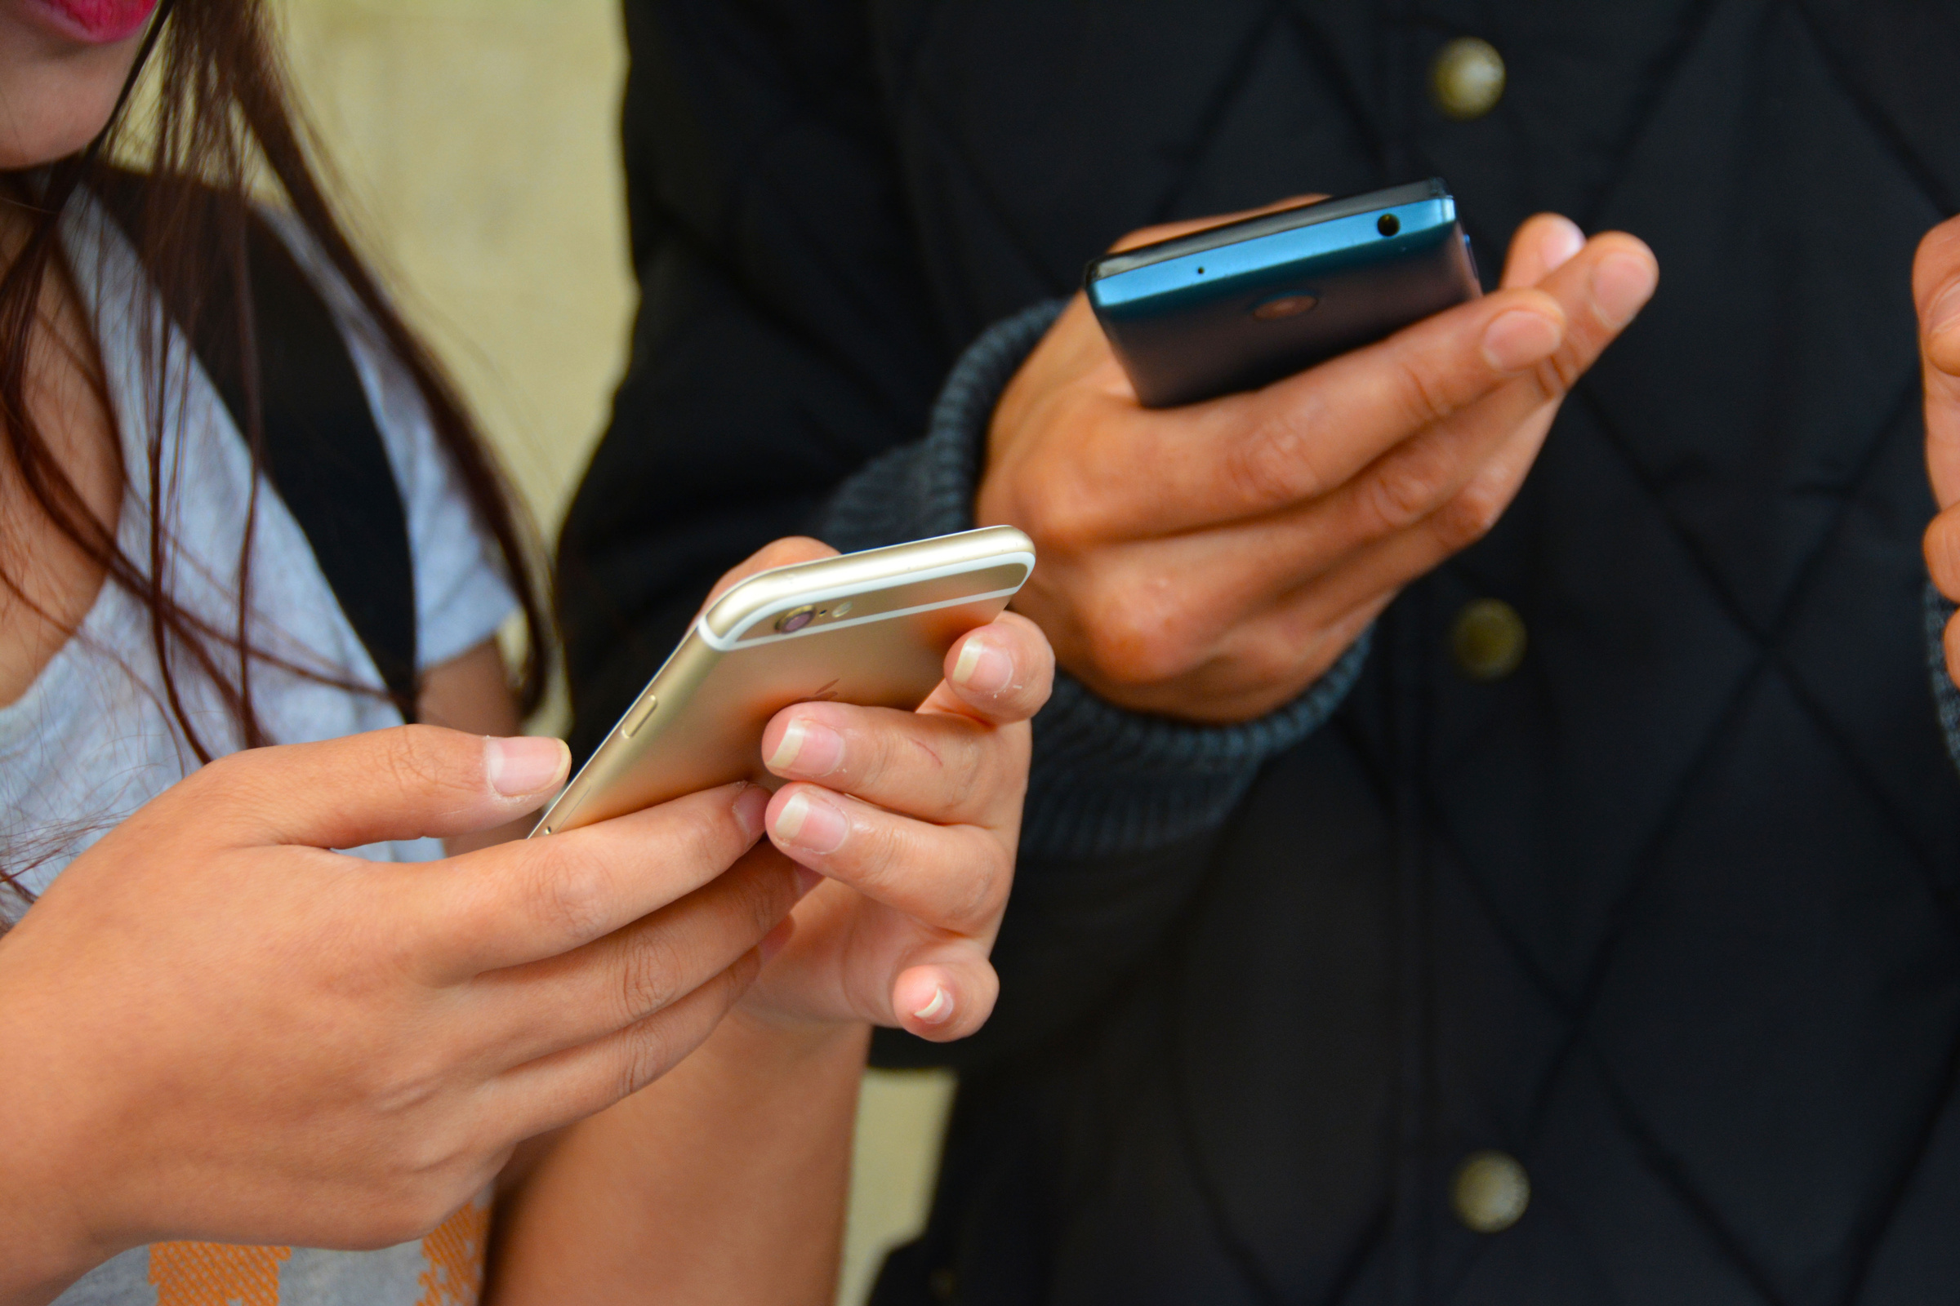
HB 379
Provides that teachers have the authority, through their established classroom rules of conduct, to designate an area for students to place their cell phones and other wireless communication devices during instructional time. While students may still possess a cell phone or wireless communications device while at school, “a student may not use a wireless communications device during instructional time, except when expressly directed by a teacher solely for educational purposes. A teacher shall designate an area for wireless communication devices during instructional time.”

Slide 3

HCPS WIRELESS COMMUNICATION
AND OTHER ELECTRONIC DEVICES
PROPOSED REVISED POLICY
Grades PreK through 5
Grades 6 through 8
Grades 9 through 12
Students who bring WCDs to school must ensure that they remain on silent mode and completely out of view for the entire school day. Classroom teachers may also provide, and student may utilize, a cell phone storage area in their classroom.
Students who bring WCDs to school must ensure that they remain on silent mode and completely out of view for the entire school day except for the student’s lunch period or as expressly authorized by the classroom teacher for a specific instructional activity. Classroom teachers may also provide, and student may utilize, a cell phone storage area in their classroom. These expectations also apply to extra-curricular and co-curricular activities that occur before or after the school day.
Students who bring WCDs to school must ensure that they remain on silent mode and completely out of view for the entire school day except for the student’s lunch period, in between class periods, or as expressly authorized by the classroom teacher for a specific instructional activity. Classroom teachers may also provide, and student may utilize, a cell phone storage area in their classroom. These expectations also apply to extra-curricular and co-curricular activities that occur before or after the school day.

Slide 4
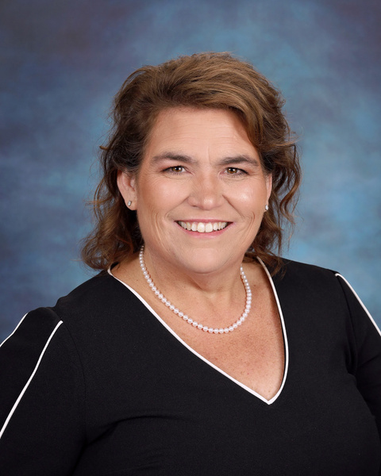
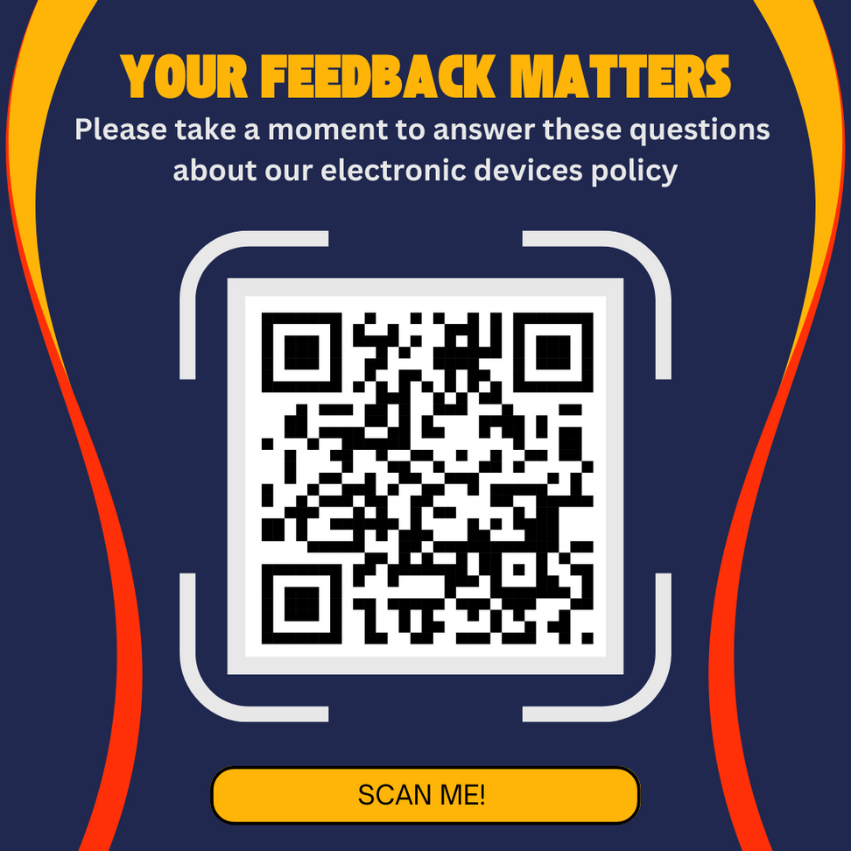
Patricia.Rendon@hcps.net
District Phone #
(813) 272-4053

